Slide 1

ICT504 IT Strategy & Leadership Week 2
ICT Strategy Implications

Slide 2
Lecture Outline
Early view of ICT Strategy.
Strategic alignment.
Business strategy.
Org infrastructure strategy.
Digital strategy.
IT infrastructure strategy.
Business model.
Strategy implementation.

Slide 3
Early ICT Strategy - Infusion vs. Diffusion
Infusion: How deeply ICT is embedded into core business functions.
Example: Coles' self-checkout systems rely heavily on ICT for real-time pricing and stock updates.
Diffusion: How widely ICT is spread across departments and decision-making.
Example: NSW Health using electronic medical records across hospitals and local clinics.

Slide 4
Early ICT Strategy - Infusion vs. Diffusion
Comparison Table:
Strategy Type | Infusion | Diffusion | Example (Australia)
Low-Low | Low | Low | Small local retail using Excel for stock only
High-Low | High | Low | An accounting firm relying on cloud storage but only in HQ

Slide 5
Early ICT Strategy - Infusion vs. Diffusion
Comparison Table:
Strategy Type | Infusion | Diffusion | Example (Australia)
Low-High | Low | High | Council systems where each department picks its own software
High-High | High | High | ATO digital services for citizens and internal ops

Slide 6
Strategic Alignment
Concept Overview: Strategic alignment means using ICT in a way that directly supports business and digital strategies.
Key Areas of Alignment:
Business Strategy: Market scope, services
Digital Strategy: Online engagement, automation
Org Infrastructure: Structure and process roles
ICT Infrastructure: Tech platforms and support
Example: Woolworths aligning loyalty programs (business) with AI-driven shopping experience (digital).

Slide 7
Business Strategy Elements
Key Focus Areas:
Scope: What markets and services do we target?
Competencies: What makes us strong? (e.g., cost, quality, innovation)
Governance: Who decides on tech investment and priorities?
Example: Afterpay's strategy relies on digital-first models with core competence in customer acquisition.

Slide 8
Organisational Infrastructure Strategy
Key Elements:
Structure: Centralised vs. decentralised ICT control
Processes: Streamlining operations, reducing manual work
HR Strategy: Hiring, training, motivating digital-savvy teams
Example: AustralianSuper restructured HR to support digital transformation and upskilling.

Slide 9
Research Discussion Questions (All Concepts)
How has digital strategy changed Australian universities post-COVID?
Response: Emphasis on hybrid models, cloud LMS, and student data analytics.
What risks come with high infusion but low diffusion?
Response: Central systems failure affects all operations; lack of flexibility.

Slide 10
Research Discussion Questions (All Concepts)
Compare ATO's ICT strategy to a small private clinic. Where do they differ?
Response: ATO has high infusion + diffusion; clinic likely low on both.

Slide 11
Hands-On Activities
Infusion Mapping: Map ICT systems used in your university by department.
ICT Gap Audit: Identify a business and list areas with poor alignment.
Strategy Reflection: Write how ICT affects decisions in a part-time job.
Digital Strategy Check: Assess your uni's digital strategy using a checklist.

Slide 12
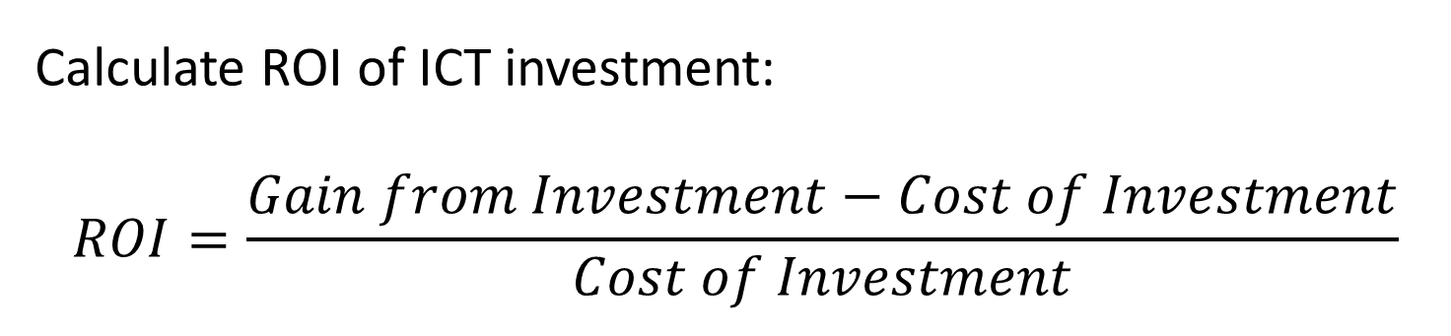
Problem Solving
Create a spreadsheet showing how ICT spending aligns with business goals across departments (Columns: Dept, ICT Used, Cost, Business Outcome).
Calculate ROI of ICT investment:
$$ROI=\frac{Gain from Investment−Cost of Investment}{Cost of Investment}$$

Slide 13
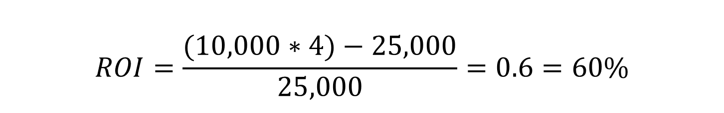
Problem Solving
Example
An ICT upgrade costs $25,000 and saves $10,000 yearly over 4 years.
$$ROI=\frac{(10,000∗4)−25,000}{25,000}=0.6=60\%$$

Slide 14
Role-Playing / Debate Question
Debate: "High diffusion without infusion is worse than high infusion without diffusion."
Yes side: Leads to chaos, no standardisation.
No side: Over-reliance on central systems is more dangerous.
Role Play: Act as CIO, CEO, and HR Head debating where to invest in ICT (e.g., digital customer service vs. back-end automation).

Slide 15
Digital Strategy
Key Components:
Technology Scope: What IT tools and applications are needed?
Systematic Competence: How well the org accesses and uses IT services
IT Governance: Rules for who controls ICT decisions, resources, and risk
Example: Monash University choosing Microsoft Teams for collaboration across departments, with clear access control policies.

Slide 16
IT Infrastructure Strategy
Core Elements:
Architecture: Defining priorities and tech standards
Processes: Daily operations supported by IT
Skills: Training and managing IT talent
Example: Telstra’s cloud-first policy aligned with infrastructure upgrade and retraining IT support teams.

Slide 17
ICT Strategy for the 21st Century
Modern Realities:
Tech is always changing – we must adapt fast
Need for flexible leadership and ICT policies
Organisations must stay alert to opportunities/threats (like meerkats!)
Regular internal + external evaluation (SWOT)
Reusable IT, upskilled people, revised processes = sustainable digital success

Slide 18
ICT Strategy for the 21st Century
Example: Qantas using AI + predictive maintenance while constantly reviewing digital KPIs.

Slide 19
Research Discussion Question
Compare ATO's ICT strategy to a small private clinic. Where do they differ?
Response: ATO has high infusion + diffusion; clinic likely low on both.

Slide 20
Research Discussion Question
How would you assess the ICT architecture of Woolworths vs. a local bakery?
Response: Woolworths has structured, scalable, automated ICT; bakery likely has basic tools (POS + inventory app).

Slide 21
Research Discussion Question
Should all organisations aim for high infusion and diffusion?
Response: Not necessarily. It depends on business size, goals, and sector risk.

Slide 22
Role-Playing / Debate
Debate: "Australian SMEs should focus more on digital strategy than IT infrastructure."
Yes: SMEs need digital channels more than backend systems.
No: Infrastructure must be strong first to support growth.

Slide 23
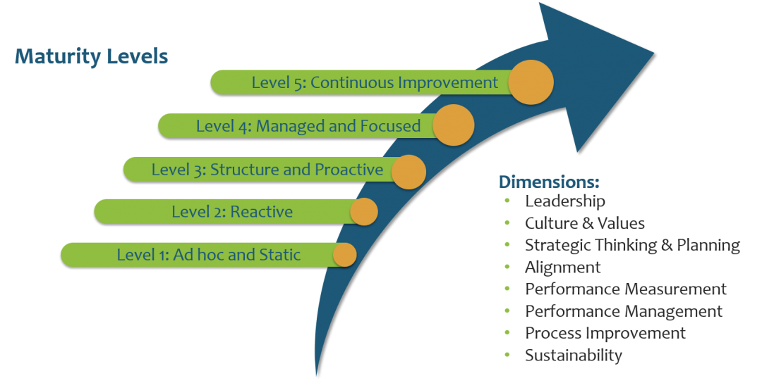
Evolving Nature of ICT Strategy (Maturity Levels)
Building future opportunities and advantages faster than your competitors. This requires program and budget planning.
https://strategymanage.com/resources/strategic-planning-basics/strategic-management-maturity-model/

Slide 24
Evolving Nature of ICT Strategy (Maturity Levels)
Maturity Levels of ICT Strategy:
Level | Description | Example (Australia)
1 | Ad hoc / Static | Local bakery using pen & paper for orders
2 | Reactive | Small business reacts to system outages with temporary fixes

Slide 25
Evolving Nature of ICT Strategy (Maturity Levels)
Maturity Levels of ICT Strategy:
Level | Description | Example (Australia)
3 | Structured | TAFE NSW has proactive planning for IT upgrades
4 | Managed | Westpac uses a defined ICT strategy and governance framework

Slide 26
Evolving Nature of ICT Strategy (Maturity Levels)
Maturity Levels of ICT Strategy:
Level | Description | Example (Australia)
5 | Continuous Improvement | Commonwealth Bank integrates AI, innovation, sustainability into ICT planning

Slide 27
Evolving Nature of ICT Strategy (Maturity Levels)
Core Dimensions:
Leadership, Culture, Strategic Planning, Alignment
Performance measurement and sustainability
Key Message: The higher the maturity, the more competitive and agile the organisation becomes.

Slide 28
Research Discussion Question
Which maturity level best fits your university? Why?
Likely Level 3 or 4 – structured with ongoing improvements.

Slide 29
Hands-On Activities
Maturity Assessment: Interview a small business and rank it from Level 1 to 5.

Slide 30
Role-Playing / Debate
Role Play: CIO, CFO, and CEO plan ICT maturity improvement with limited budget.
Prompt: Choose whether to invest in tools (tech), training (people), or process (structure).

Slide 31
Strategic Thinking vs Strategic Planning (ICT Context)
Simple Explanation:
Strategic Thinking is about creative vision. It asks: “Where could we go?”
Strategic Planning is about practical steps. It asks: “How do we get there?”
Decision Making involves making smart choices when opportunities or problems show up.

Slide 32
Strategic Thinking vs Strategic Planning (ICT Context)
Concept | Focus | ICT Example (Australia)
Strategic Thinking | Vision, new possibilities | Telstra exploring AI-powered customer support
Strategic Planning | Actions, timelines, resources | Monash Uni’s digital roadmap for blended learning
Decision Making | Response to changes/threats | Woolworths adapting supply chain tech during COVID

Slide 33
Strategic Thinking vs Strategic Planning (ICT Context)
Real-World Focus:
Strategic thinking = imagining a better digital experience for customers
Strategic planning = defining tasks, budgets, and teams to deliver it
Decision making = changing cloud vendors when costs spike unexpectedly

Slide 34
Research Discussion Questions
Why is strategic thinking important before starting a digital transformation?
Response: Because it ensures the organisation’s vision fits future market needs.
Can an organisation have planning without thinking? What happens?
Response: Yes, but it may focus on wrong goals or repeat outdated patterns.
Which ICT decisions in an Australian university reflect strategic planning?
Response: Implementing new LMS platforms and automating admin tasks.

Slide 35
Hands-On Activities
Scenario Writing: Imagine you are CIO of a small Aussie fintech. Write:
A strategic vision for 3 years
3 key steps to implement it (strategic plan)
One decision to make when tech risk happens
ICT Gap Table: Use Excel to list:
System - Current State - Vision (Thinking) - Plan (Steps) - Risk (Decision?)

Slide 36
Problem Solving
Problem: Is the Cloud Strategy Sustainable Over 3 Years?
Given:
Setup Cost: $15,000 (one-time)
Monthly Ongoing Cost: $1,000
Annual Savings: $5,000

Slide 37
Problem Solving
Step-by-Step Breakdown
Calculate total cost over 3 years
Setup: $15,000
Monthly for 3 years = 36 months × $1,000 = $36,000
Total Cost = $15,000 + $36,000 = $51,000

Slide 38
Problem Solving
2. Calculate total benefit (savings) over 3 years
Annual Savings: $5,000
Total Savings = 3 × $5,000 = $15,000
3. Find Net Impact
Net Loss = $51,000 - $15,000 = $36,000

Slide 39
Problem Solving
Answer:
X Not sustainable based on cost alone over 3 years.
Recommendation:
If this move supports long-term goals like:
Innovation (e.g., automation, AI readiness),
Scalability (growing user base),
Security & compliance (e.g., ISO 27001 hosting),
…it might still be strategically worth it.

Slide 40
Role-Playing / Debate
Debate: “Strategic planning is more important than strategic thinking.”
Yes side: Without planning, thinking is just dreaming.
No side: Without thinking, you might plan the wrong thing.
Role Play: Roles: ICT Director, Finance Manager, Project Manager Situation: Decide whether to invest in cybersecurity or mobile app development first. Prompt: Each person presents strategic thinking AND planning justification for their side.

Slide 41
Strategy Development
Simple Explanation:
Strategy development helps organisations respond to the market by knowing:
What they already have (current assets)
What they need (resources or changes)
How to compete, grow, and innovate
It encourages asking questions like: What? Why? When? Where? Who? How?

Slide 42
Strategy Development
How to win? | Advantage via price, service, etc. | Canva’s ease-of-use and freemium model
What do we have? | Existing skills or tech | CSIRO’s AI labs and datasets
What do we need? | New tech or talent? | Hiring blockchain developers in fintech
How to change? | Structure, process, mindset shifts | NAB’s digital branch transformation

Slide 43
Research Discussion Questions
How does innovation support ICT strategy development?
Response: Innovation helps adapt faster to tech trends and customer needs.
Why is understanding your organisation’s assets crucial?
Response: So you can leverage strengths and address weaknesses in strategy.
Should Australian universities invest more in digital education tools? Why?
Response: Yes, to remain globally competitive and inclusive.

Slide 44
Hands-On Activities
Innovation Challenge: Create a digital product idea for a local business in Australia. Identify:
The market need
Existing ICT tools
New assets or skills needed

Slide 45
Hands-On Activities
Strategic Canvas: Fill in these columns:
Question | Answer for Local Business (e.g., RMIT Cafe)
Where to compete? | Local food delivery + mobile ordering
What do we have? | POS system, website, loyal student customers
What do we need? | App, delivery system, social media presence

Slide 46
Math/Problem Solving (Resource Planning)
If you plan to expand into online delivery:
Website upgrade: $2,500
Mobile App: $10,000
Hiring delivery staff (2 people for 12 months at $20/hour for 10 hrs/week)
Calculation: Staff Cost = 2 * 20 * 10 * 52 = 20,800 Total Cost = 2,500 + 10,000 + 20,800 = 33,300

Slide 47
Role-Playing / Debate
Debate: “ICT strategy should focus more on market responsiveness than internal efficiency.”
Yes side: Customer needs change fast. Tech must follow them.
No side: Without internal efficiency, you can’t scale or respond.

Slide 48
Role-Playing / Debate
Role Play: Role: You are the strategy advisor to a startup in Melbourne. Prompt: Advise your team on:
Where to compete
What asset to build next
How to use ICT to respond to Gen Z users

Slide 49
Business Strategy Types – Cost Leadership vs. Differentiation
Simple Explanation: Business strategies help companies succeed in different ways:
Cost Leadership: Be the lowest-cost producer. Focus is on efficiency, strict budgeting, and economies of scale.
Differentiation: Stand out with unique products or services. Focus is on innovation, branding, and quality.

Slide 50
Business Strategy Types – Cost Leadership vs. Differentiation
Strategy Type | Focus | Common Traits | Australian Example
Cost Leadership | Efficiency & Low Prices | Tight cost control, clear roles, productivity | Aldi Australia's pricing model
Differentiation | Unique Value | R&D, branding, skilled people, tech leadership | Atlassian’s developer tools, Canva

Slide 51
Business Strategy Types – Cost Leadership vs. Differentiation
Real-World Focus:
Cost Leadership: Automate routine tasks, reduce waste, manage labor strictly.
Differentiation: Offer premium services, use tech to innovate, build strong trust and culture.

Slide 52
Research Discussion Questions
Why might a startup in Australia prefer differentiation over cost leadership?
Response: Because they may lack resources to compete on price but can offer something unique.
What are the risks of only pursuing cost leadership in tech industries?
Response: Risk of being outdated or losing customer interest when innovation matters more.

Slide 53
Research Discussion Questions
Can a company do both strategies at once? Why or why not?
Response: It’s hard but possible—requires balance. Example: Qantas offers both Jetstar (cost) and premium flights.

Slide 54
Hands-On Activities
Strategy Mapping Exercise:
Choose an Australian company (e.g., Bunnings, Telstra, Zip).
Identify if they follow Cost Leadership or Differentiation.
Write 3 reasons why, based on their website or news reports.

Slide 55
Hands-On Activities
Company Comparison Table (Excel):
Company | Strategy Type | Key Traits | ICT Use Example
Aldi | Cost Leadership | Low overhead, basic layout | Inventory & price systems
Canva | Differentiation | Design innovation, UI/UX focus | Online SaaS tool, AI features

Slide 56
Math/Problem Solving
Cost Efficiency Calculation:
Scenario: Your ICT team automates a customer service task.
Manual cost = $40/hour, 5 hours/day = $200/day
Automation cost = $6,000 setup, $100/month maintenance
Question: Is automation cheaper over 12 months?

Slide 57
Math/Problem Solving
Solution:
Manual: $200 × 20 working days × 12 months = $48,000
Automation: $6,000 + ($100 × 12) = $7,200
Savings = $40,800 → Cost leadership success!

Slide 58
Role-Playing / Debate
Debate: “Cost leadership kills innovation.”
Yes side: Too much focus on price limits room for R&D
No side: Innovation can come from process improvements (e.g., automation, logistics)

Slide 59
Role-Playing / Debate
Role Play: Roles: CEO, CTO, CMO (Chief Marketing Officer)
Scenario: A new product must be launched.
Task: Each role must argue for either investing in innovation (differentiation) or reducing cost to match competitors.

Slide 60
Business Model – What It Really Means
Business Model = How the business makes money + delivers value
Focus Type | Description | Example (Australia)
Economic | Profit through price or scale | Bunnings using scale + warehouse sales
Operational | Great internal processes | Atlassian’s agile dev + support model
Strategic | Strong market position | Canva’s global platform design
Modern Tip: Include partnerships, digital platforms, and value loops.

Slide 61
Class Tasks
Model Breakdown: Pick any Aussie startup. Identify:
Revenue stream
Customer base
Key partnerships

Slide 62
Debate / Role Play
Debate: “Digital business models work better than traditional ones in Australia.”
Yes side: More scalable, lower overheads
No side: Trust, face-to-face still valued

Slide 63
Competitive Advantage (Quick Lecture Style)
3 Ways to Win:
Operational Excellence – Be efficient (e.g., Amazon AU)
Customer Intimacy – Know and serve them well (e.g., Afterpay)
Product Leadership – Best innovation (e.g., Cochlear implants)

Slide 64
Competitive Advantage (Quick Lecture Style)
Approach | Strength
Operational Excellence | Cost + speed
Customer Intimacy | Trust + personalisation
Product Leadership | R&D + innovation

Slide 65
Task
Choose an Australian supermarket and identify its competitive advantage style.
Woolworths: Customer intimacy through loyalty programs.
SWOT Tale:
Strength | Weakness | Opportunity | Threat
Fast checkout | High cost | Delivery drones | Market price war

Slide 66
Strategy Implementation
Key Messages:
Strategy must move from plan to action
You measure it by performance, delivery, and profit
Separate what you intended vs what really happened

Slide 67
Strategy Implementation
Area | Example (Australia)
Plan | Commonwealth Bank digital banking rollout
Realised | Partial delays due to backend issues
Performance KPIs | App users, load speed, support ticket drop

Slide 68
Engagement Questions
What happens if great strategy is never implemented?
Response: No results, just paperwork.
What’s one ICT example where strategy failed in execution?
Response: Census 2016 website crash (planning gap in scale)

Slide 69

Reading Materials

Slide 70
Articles
C.H. Sullivan, ‘Systems planning in the information age’, Sloan Management Review, Winter, 1985, 3–11.
J.C. Henderson and N. Venkatraman, ‘Strategic alignment: Leveraging information technology for transforming organisations’, IBM Systems Journal, 32, 1, 1993, 4–16.
H.T. Ansoff, R.P. Declerck and R.L. Hayes, eds, From Strategic Planning to Strategic Management, John Wiley & Sons, New York, 1976.
F.W. Gluck, S.P. Kaufmann and A.S. Walleck, ‘Strategic management for competitive advantage’, Harvard Business Review, July–August 1980, 154–161.
W.C. Kim and R. Mauborgne, ‘Blue Ocean Strategy, Expanded Edition: How to Create Uncontested Market Space and Make the Competition Irrelevant, Harvard Business School Press, Boston, 2015.

Slide 71
Thank you
Happy a Learning Day
Dr. Farshid Keivanian

